Slide 1
The Power of Niagara University
Making an IMPACT
Through career-based service learning
Location: Academic Complex – Room 125

Slide 2
What is IMPACT?
Connect students with community needs.
Project-based learning integrated into academic curriculum.
Service opportunities aligned to career interests and skill sets.
Allows for face-to-face and virtual service projects.

Slide 3
The Need for IMPACT
Workforce Development
Unemployment Rates:
Health & Wellness
NF zip code 14301 is a Food Desert
Early Childhood Education
NF: 8.6% have Bachelor’s Degree or higher
NF: 37.4% children under the age of 5 living in poverty
Housing
Niagara County: 5.9%
73% NF children are eligible to receive free or reduced breakfast and lunch
57.2% NF residents are homeowners
Literacy
90% NF houses built before 1979
30% functional illiteracy rate (Niagara County)
Niagara Falls: 7.4%
New York State: 4.6%
POVERTY
Notes:
Our local communities have great needs – here’s a snapshot of just a few listed within the pillars of the Levesque Institute

Slide 4
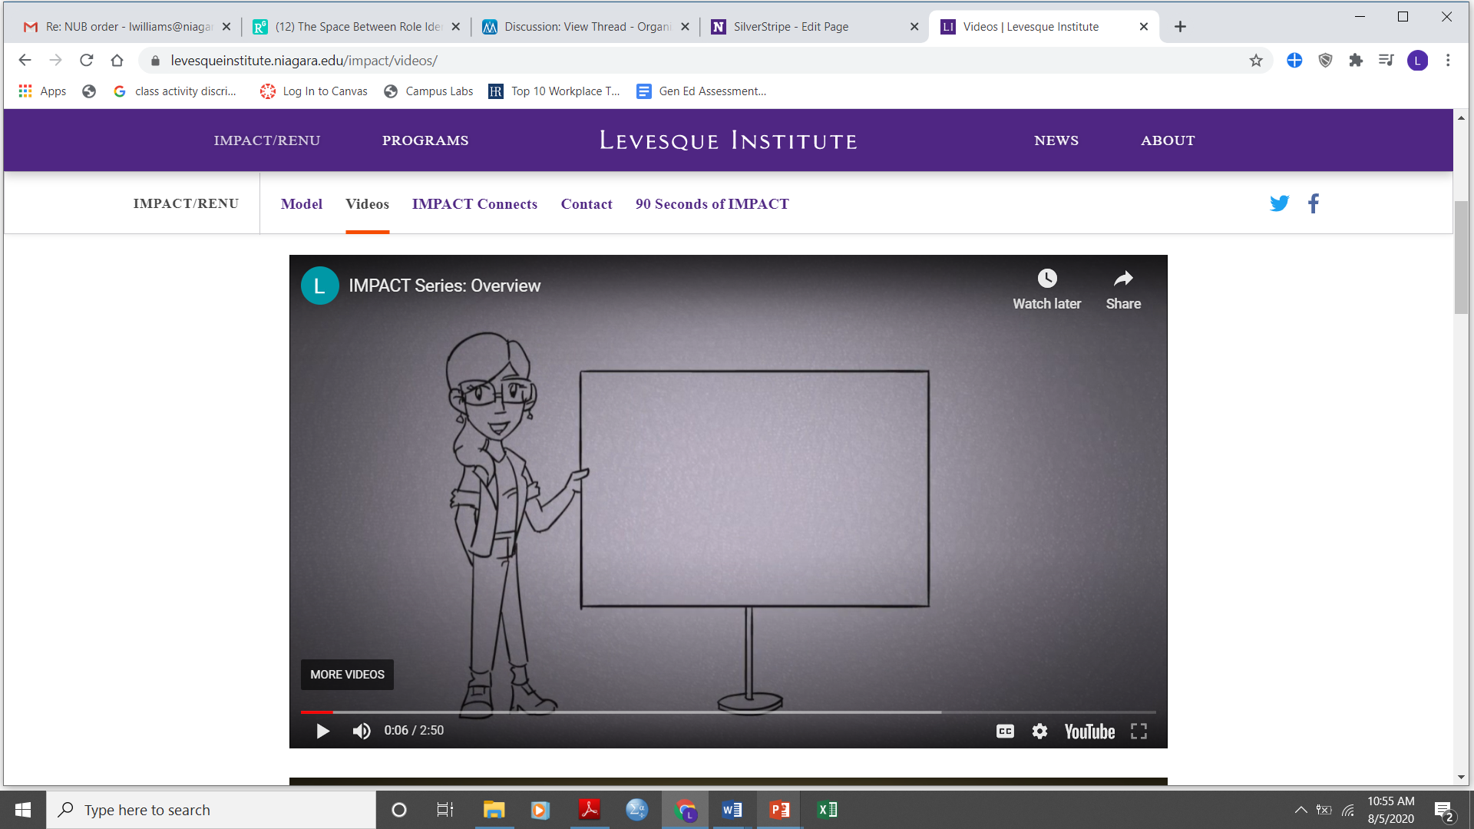
IMPACT Overview
https://www.youtube.com/watch?time_continue=6&v=_2-kyBTBdUY&feature=emb_logo
Click link to play
Notes:
https://youtu.be/_2-kyBTBdUY

Slide 5
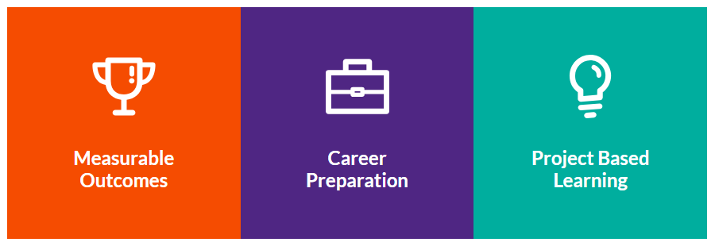
IMPACT is…
(Click each box to Play)
Notes:
Measurable Outcomes - https://youtu.be/3Kh5SBhQoHk
Career Preparation - https://youtu.be/Jd7Az2ZIeto
Project Based Learning - https://youtu.be/Jd7Az2ZIeto

Slide 6
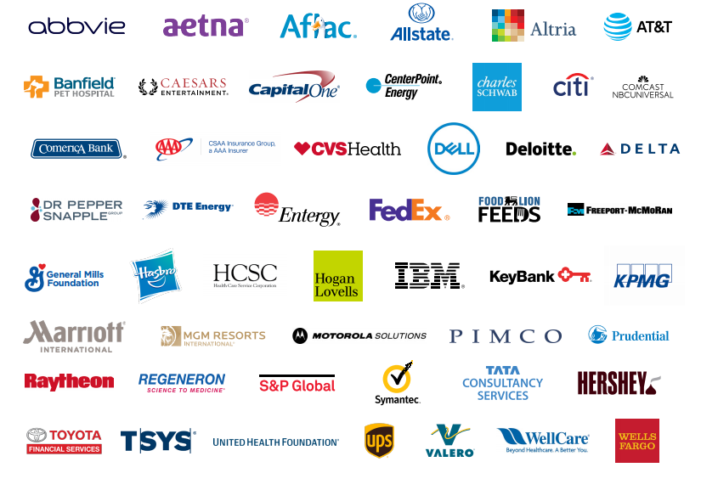
Service matters to…
Value of Volunteer Labor
$27.53/hour
Value of Skills-Based Service
Based on Major
…and they hire NU students
Civic50.org
Notes:
IMPACT projects provide opportunities for students to gain real-world experience in their field of study, to better prepare you for future careers and provide you with concrete experiences that you would be proud to include on your resume.
IMPACT projects are great opportunities for students who are still unsure about what direction that want to go in – to “sample” different careers, so to speak, through a project that benefits the community while aiding in the student’s decision-making.
We know that employers also care about service. Listed on the slide are the Civic50 – an annual list of the 50 most community-minded companies in the nation, as determined by a survey. These are public and private companies with U.S. operations and revenues that exceed $1 billion annually. They are selected based on four criteria: Investment in community engagement; Integration of community engagement programs with business interests and functions; Institutionalization of community engagement through organizational policies, systems, incentives; and how the company measures the social impacts and outcomes of their community engagement programs.
We know that service matters to these companies. In fact, 56% of these companies include community engagement in their performance reviews. 78% person of these companies actively measure and report on their social impact. More than half of these companies connect community engagement with skills development; and 25% of volunteer experiences are skills-based.
Time spent in service carries a great value. According to independentsector.org; the value of a volunteer hour is $24.69. That number is more than six times greater when the volunteer service utilizes a volunteers skill set. For example, the time an accountant spends doing free tax preparation assistance for senior citizens would be valued at $150/hour, whereas an accountant spending time cleaning up a neighborhood would be valued at $24.69/hour.

Slide 7
IMPACT Project Phases
Discover
Action
Plan
The IMPACT Program
Plan your project!
IMPACT
Commit
Niagara University
Your interests, skills and goals
The community
What are the needs?
Expected outcomes?
Career skills involved?
Implement the project
Gain hands-on, career related experience
Analyze the outcomes of your project (were they reached?)
Determine the IMPACT your project made
Graduate with a commitment to serve your community
Vincentian Mission
An IMPACT project could span…
One semester
One year
Two Years
Four Years
…it all depends on the project and the needs being addressed.
Notes:
To engage in projects like those listed on the previous slide, IMPACT has put together a five phase process for the development, implementation, evaluation and commitment of projects and students.
*Please read through the phases above, noting that these phases could be completed in a semester, year, multiple years or could be ongoing projects.

Slide 8
Entrepreneurism/Academic Integration
Arts & Sciences
Education
Hospitality & Tourism Management
Business
Health & Wellness
Safe Neighborhoods
Cultural Events
Energy Issues
Life Skills & Social Context
Drug & Alcohol Rehab Programs
NF National Heritage Area/
Discover Niagara Shuttle
Economic Development
Workforce Development
Job Coaching
Entrepreneur Training
Family Business Center
Food Marketing & Food Industry
Entrepreneurship
Small Business Development
Family Literacy Programs
Tutoring Services
Parent/Family Workshops
Developmental Disabilities Job
Placement Training
Mental Health Counseling Services
Workforce Training
Expand Tourism Efforts
Community Events Planning
Children & Family Recreation Events
Community Recreation Opportunities

Slide 9
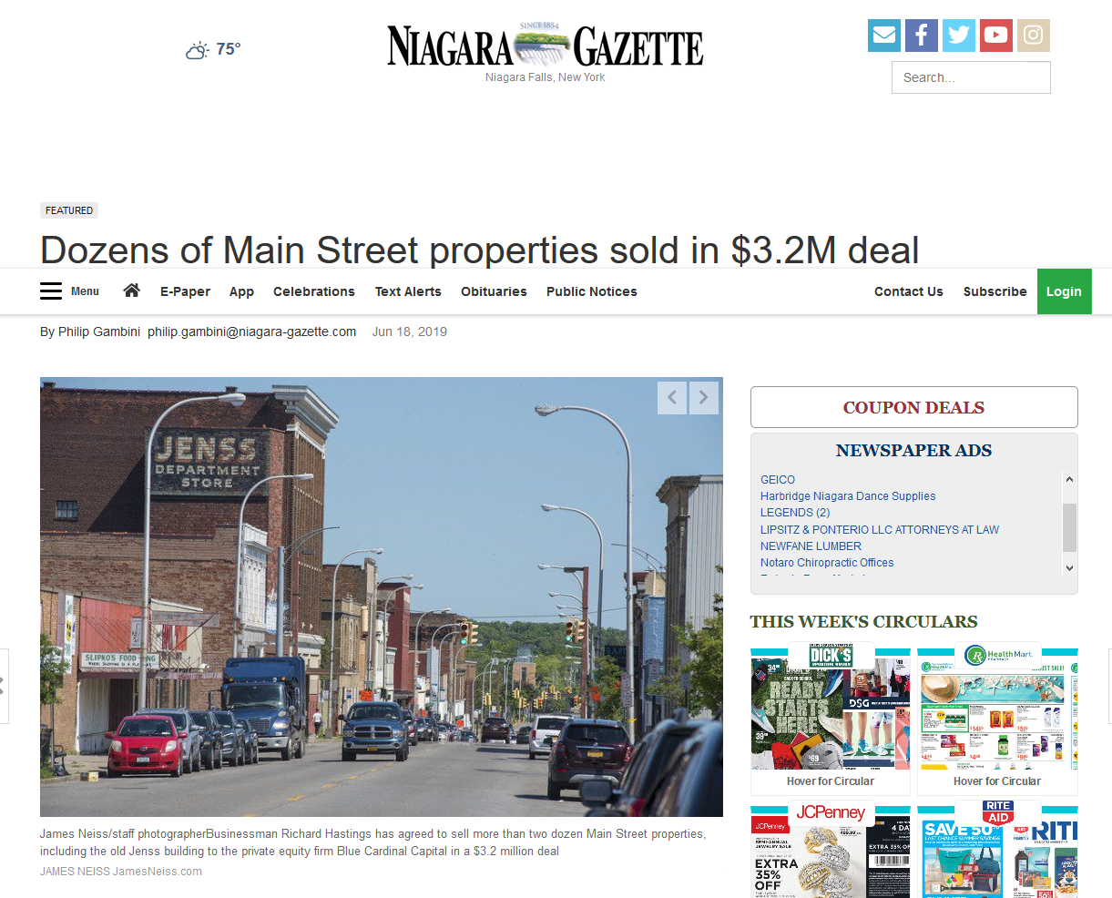
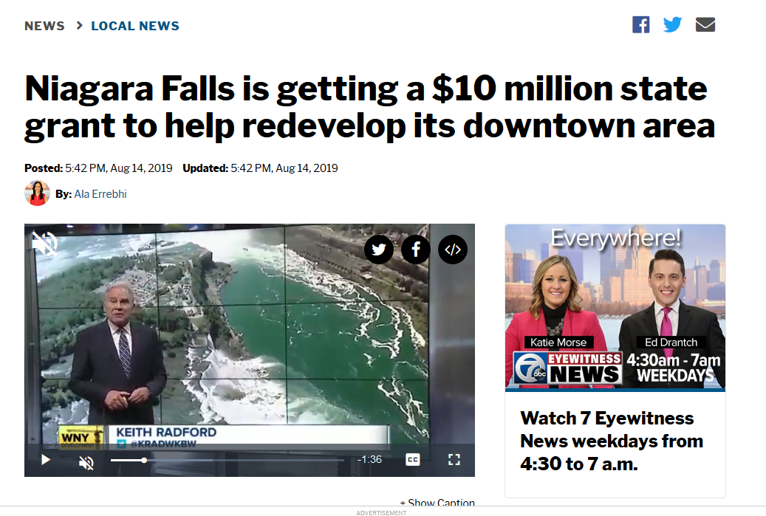
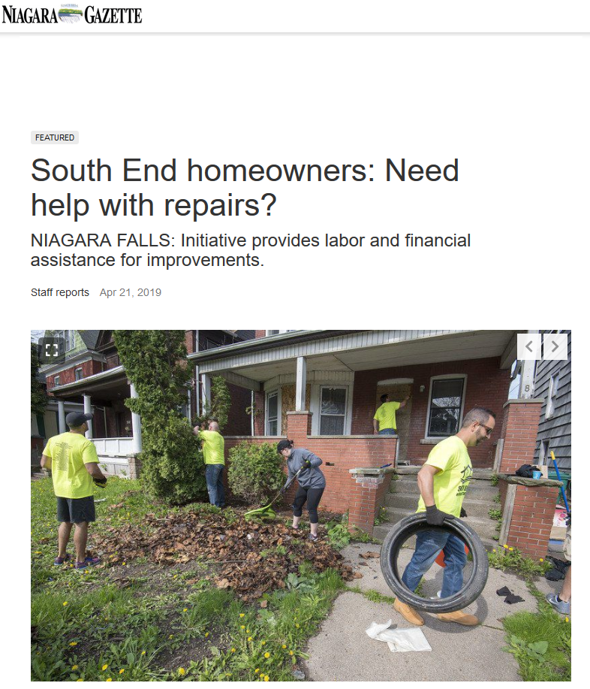
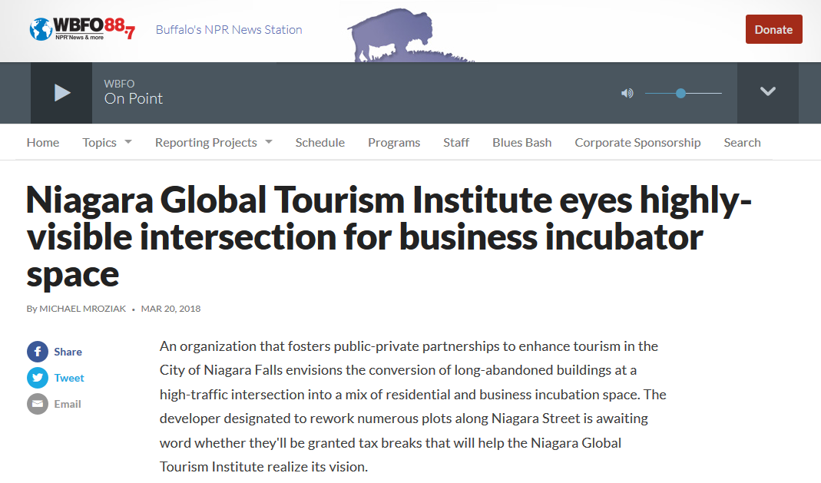
Imagine the Possibilities – Think like an Entrepreneur

Slide 10
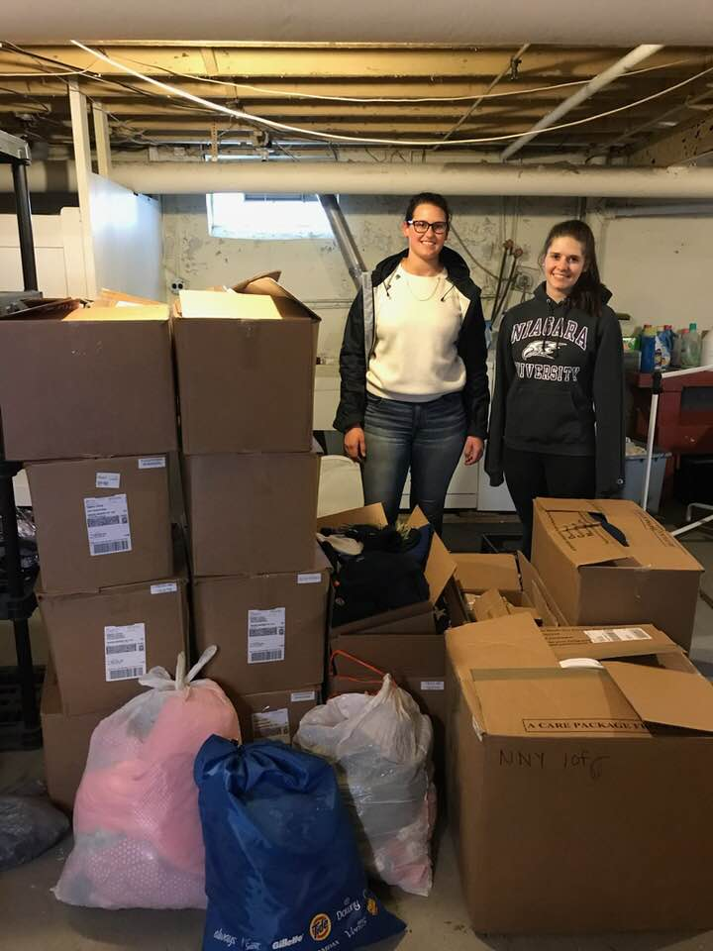
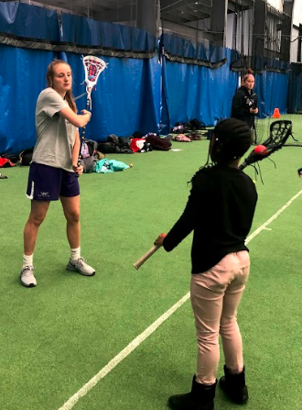
Project-based IMPACT Examples
Accounting:
Volunteer Income Tax Assistance (VITA)
Education:
Linking Literacy to Movement
Social Work:
Street Outreach/ Point In Time count

Slide 11
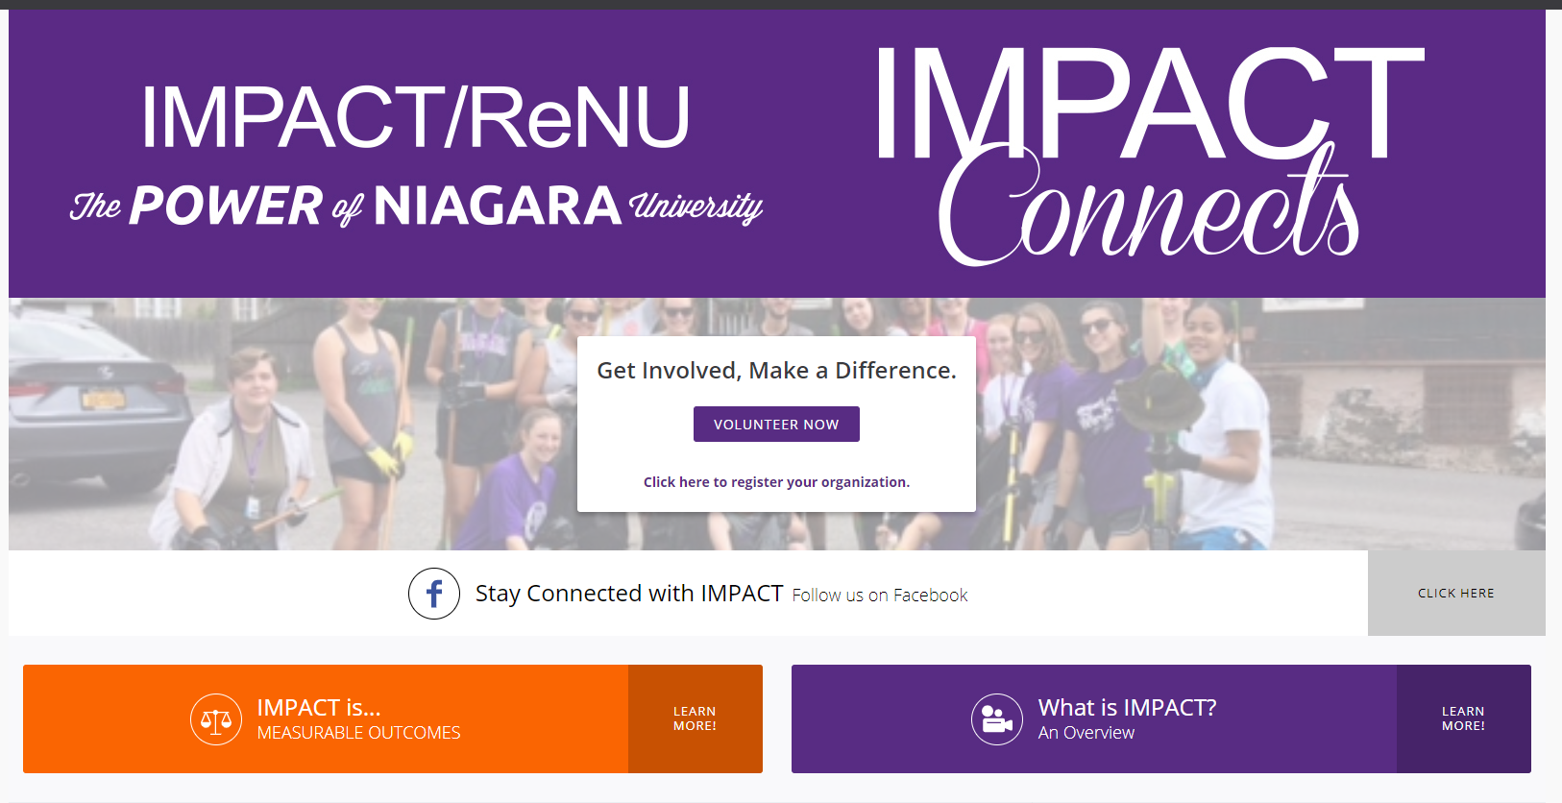
Sign up today – visit: Niagara.galaxydigital.com – use your PurplePass credentials
Notes:
Have students sign up IN CLASS!!
Students are required to log service via IC

