Slide 1
NUB 102
Diversity &
Inclusion (cont.)
Block 3b, Fall 2019

Slide 2
Unpacking Bias
Bias is “a prejudice in favor of or against one thing, person, or group compared with another, usually in a way considered to be unfair.”*
Questions to consider:
  What is “unconscious bias” and what unconscious biases might we or others have?
  How do unconscious biases affect those who harbor them or the individuals or groups they are directed toward?
*Source: https://students.case.edu/division/biasreporting/glossary.html

Slide 3

Defining Unconscious Bias
How would you define unconscious bias?

Slide 4
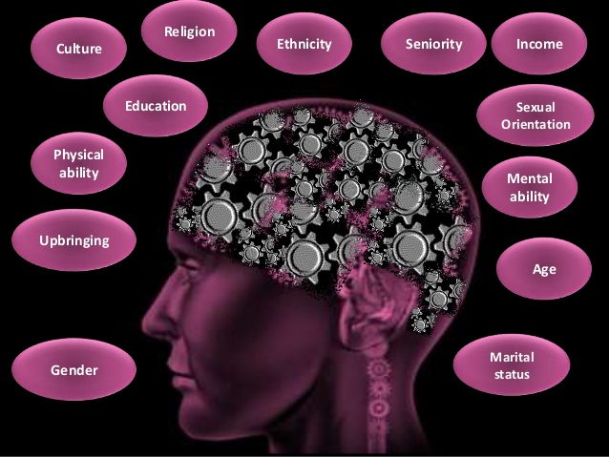
Unconscious Bias
“Occurs when someone consciously rejects stereotypes and supports antidiscrimination efforts but also holds negative associations in their mind unconsciously.”*
*Source: https://students.case.edu/division/biasreporting/glossary.html
Note the two-part definition.

Slide 5
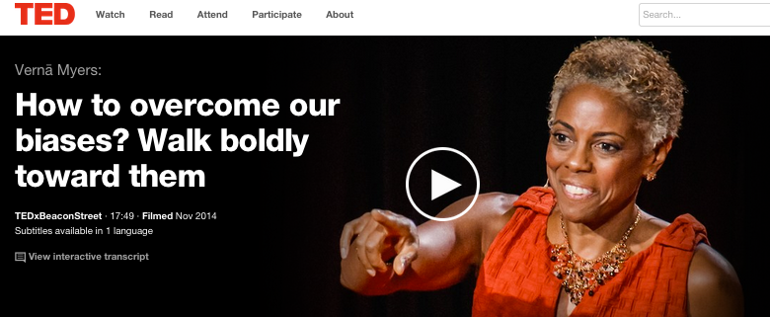
Video #1
This TEDtalk features Verna Myers, a former lawyer and diversity advocate. As you listen, think about the ways in which Myers is in conversation with today’s lesson on unconscious bias.
Click here for video.

Slide 6
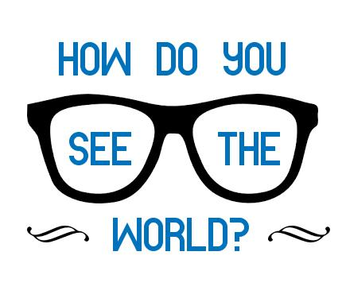
Video #1 Debrief
Throughout the video, Myers…
Makes frequent references to and provides examples of unconscious bias
Implicitly refers to the two-part definition of unconscious bias

Slide 7
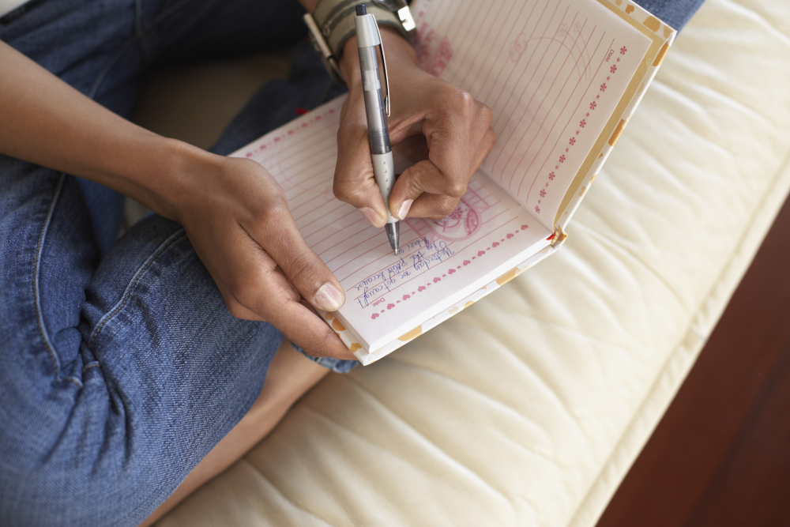
Journaling Activity
1. “Who is your default?”
2. “Who do you trust and who are you afraid of?”
3. “Who do you implicitly feel connected to? Who do you run away from?”
4. “Who’s in your inner circle? Who’s missing? How many authentic
relationships do you have with people who are different from you in
terms of gender/sex, gender identity, race, ethnicity, etc.?”
NUB Planners, pg 195

Slide 8
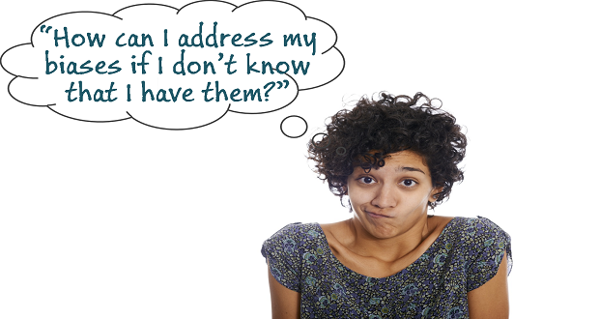
Video #1: Open Discussion
1. What did you think of Myers’ talk? 2. What did you learn from it? What moved or inspired you?
3. What examples of analytical speaking (Block A) did you hear? 4. What was Myers’ “call to action” and what did you make of it? 5. What’s the takeaway for you after watching, discussing, and journaling about this talk?
*Feel free to also share your responses to the journaling questions.

Slide 9
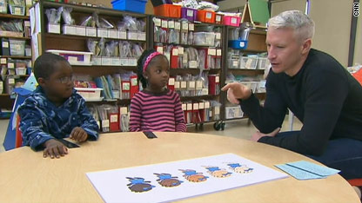
Video #2
This video shows how unconscious bias can form in early childhood
Pay attention to your thoughts, opinions, and observations for discussion afterwards
Click here for video.

Slide 10
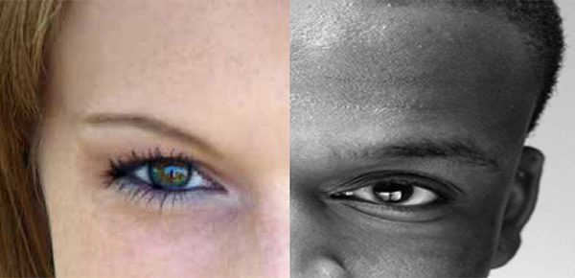
Video #2 Debrief
The video speaks to these two definitions of unconscious bias:
“Occurs when someone consciously rejects stereotypes and supports antidiscrimination efforts but also holds negative associations in their mind unconsciously.”
“Refers to a bias that we are unaware of, and which happens outside of our control. It is a bias that happens automatically and is triggered by our brain making quick judgments and assessments of people and situations, influenced by our background, cultural environment and personal experiences.”
Examples in the video
Sources: https://students.case.edu/division/biasreporting/glossary.html; https://www2.warwick.ac.uk/services/ldc/researchers/-
opportunities/development_support/e_and_d/unconscious_bias/unconscious_bias_-2_june.pdf

Slide 11
Video #2 Debrief (cont.) Internalized Racism
The belief that people of color who are victimized by racism begin to internalize it.
They begin to internalize, to inwardly believe and sometimes outwardly act, the beliefs and values of the dominant culture toward their racial or ethnic group.
Internalized racism can be conscious or unconscious—just like bias.
Examples in the video

Slide 12
Video #2: Open Discussion
1. What were some of your points of interest or confusion regarding the video?
2. What did you think of the study that was conducted?
3. Did any of the children’s responses make you uncomfortable? Why?
4. What was positive and optimistic about some of the children’s responses?
5. Where do you think the children got their beliefs from, whether positive or negative ones?
6. Spencer quote: What does she mean? What are some specific examples either hypothetically or in your own experience?
7. Were there any aspects of the study itself that you made you uncomfortable? Did you observe any potential flaws in the study?
8. What are some examples where unconscious bias might be evident in—or affect--your own discipline and future profession?
9. What’s the takeaway for you from this video and larger topic of unconscious bias?

Slide 13
Closing Thoughts
We all have some degree of unconscious bias swirling about in our brains, and becoming aware of our biases and consciously working to eliminate them is one way to produce individual and social change.
Again, because biases are learned behavior, they can also be unlearned.
On a positive note, Myers provided many suggestions for eliminating our biases, noting that “looking within and changing ourselves” is the first step. We must face our bias, have relationships with people who are different from us, go against the stereotypes, cultivate positive imagery and associations, and so on.
Most importantly, Myers encourages us to be an upstander (an advocate or an ally) rather than a bystander—to say and do something when we hear others express their bias. This is yet one more way to ensure that our campus community is a safe and welcoming place for all people.

