Slide 1
The Sixth Week Module 6b Awareness & Action
NUB 2021

Slide 2
Homework Assigned in Module 5: Jackson Katz’s Ted Talk
Open Discussion

Slide 3
Microaggressions
What is a microaggression?
A comment or action that subtly and often unconsciously or unintentionally expresses a prejudice attitude toward a member of a marginalized group (Merriam-Webster, 2017)
What are some examples of microaggressions?
Check out your handbook on pages 55-56
Optional Video Example: What Kind of Asian Are You?

Slide 4
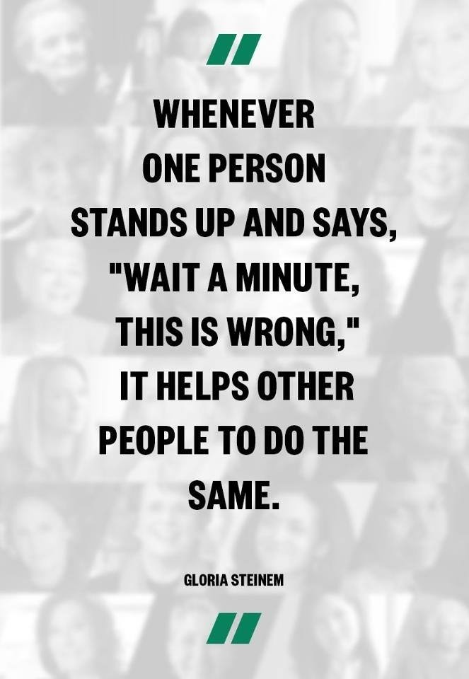
Recognizing & Taking Action
Conduct unbecoming of an NU student
Violence (in all forms)
Discrimination
Race/Ethnicity
Sex/Gender
Gender Identity
Sexual Orientation
Socioeconomic Class
Physical/Mental Disability
Religion
Age

Slide 5
Becoming an “Upstander”
What is an “Upstander”?
Someone that intervenes to help reduce or eliminate violent and/or inappropriate acts.
The 3 Ds of Intervention
Direct
You intervene directly; take action yourself
Distract
You take action to divert attention from the situation
Delegate
You enlist or appoint someone else to help in intervening

Slide 6
Scenario 1: Stalking
You and your friends, Mary and Jill, are studying at the library. While studying, you notice Mary is continuously checking her ex-boyfriend, Shane’s social media pages. Mary shares with you that she is keeping track of where Shane is so she can “accidently” run into him on campus. She excitedly states that she knew he would be at the library this afternoon, and sees him walking into the study area now. Mary starts to get up from the study table to walk towards Shane.
How would you intervene?
Direct
Distract
Delegate

Slide 7
Scenario 2: Intimate Partner Violence
During the holiday season, you are shopping at Target for some gifts. As you pass the home goods department, you see Sally (a girl from your English class this semester) and her boyfriend Mitchell in the towel aisle. Mitchell has a firm, twisting grip on Sally’s arm, and is loudly telling her that she is not allowed to spend any more of her money on frivolous purchases. Sally looks visibly upset, distraught, and worrisome.
How would you intervene?
Direct
Distract
Delegate

Slide 8
Scenario 3: Sexual Assault
It is the first week of classes, and you and a few new friends decide to attend a student party off campus. You arrive at the party to find many students drinking and several heavily intoxicated. While chatting with some other students, you see your friends, Carolyn and Mark – both drunk and stumbling up the stairway – headed towards a bedroom.
How would you intervene?
Direct
Distract
Delegate

Slide 9
Scenario 4: Microaggressions & Social Isolation
During lunch time, you and your friend Amy head to Gallagher to grab a sandwich and look over your notes for an upcoming test you both have later in the afternoon. When looking for a place to sit, you notice that several students are avoiding sitting by Alex, a student who stands out as being different from others in many ways. You overhear one student say, “Did you see Alex’s project in class today?” and another student replied, “Yeah, it was so gay!” and then the group of students erupt into laughter.
How would you intervene?
Direct
Distract
Delegate

Slide 10
A Fourth “D” of Bystander Intervention
Delay
Following up or checking in with someone when you hear that an incident has already occurred
Example:
When you return to campus after a weekend spent at home, you overhear some students talking about how your friend, Avery has a black eye and was visibly upset after his ex left his dorm room last night. When you hear this, you make a plan to stop by Avery’s room to check in with him.
Helpful Hints:
Delay is NOT an option when you see a situation that is about to occur.
Be sure to know the resources available on and off campus

Slide 11
Class Activity
Scenario Development & Role Playing
Gather into groups of 3 or 4
Within your group:
Develop a scenario
Come up with three bystander responses for your scenario
Direct, Distract, Delegate
Take turns acting! Each group will be given a chance to showcase their scenario and responses to the class!

